Slide 1
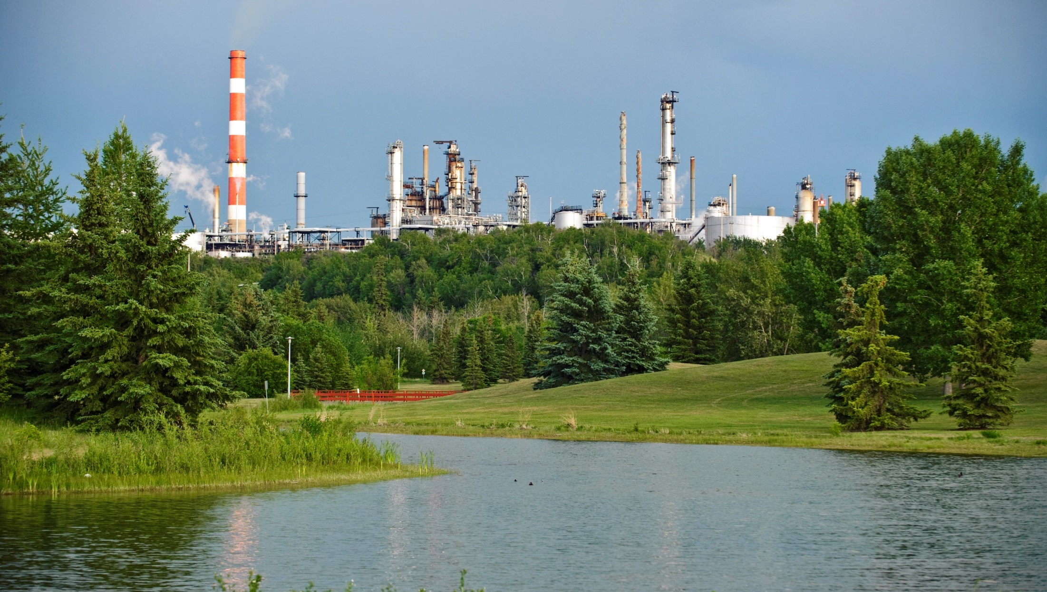
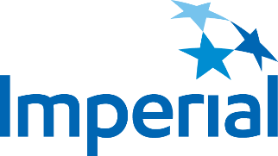
Risk Assessment and Management
ENGG 404 - Fall Term 2019 Stephen Karpala, P. Eng, Process Safety and Risk Engineer

Slide 2
Learning Outcomes
Provide an introduction to Imperial and Strathcona Refinery
Explain why risk management systems are critical to our success as a company
Explain how risk management evolved within Imperial
Explain how Imperial uses risk management systems through:
Comparison of Imperial’s framework with APEGA model
Showing how system elements work together
Developing the concept of “Safety as a Value” and embedding a risk management culture within an organization

Slide 3
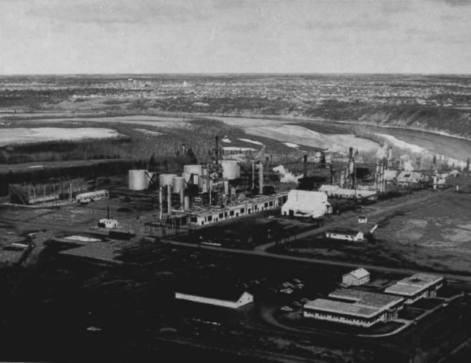
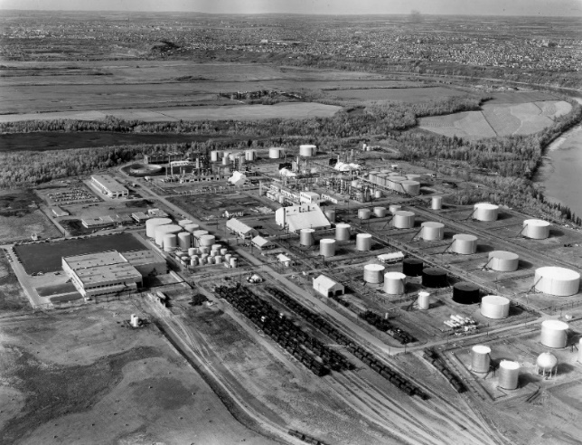
Imperial’s History - 70 Years of Refining in Alberta
1947 - 1948 Leduc #1 discovery; opening of original ‘Edmonton Refinery’, rated for 7 kbd
1949 - 1969 Various expansions to 26 kbd; addition of Lubes facilities in 1955
1976 New 145 kbd ‘Strathcona Refinery’, shutdown Winnipeg, Regina, Calgary refineries
1981 Expansion to 179 kbd, new Asphalt pipestill to support Cold Lake commercialization
1985 Purchased idle Texaco Refinery (Southlands)
2003 - 2006 low sulphur investments for mogas and diesel
2016 facility modifications for ultra-low sulphur mogas

Slide 4
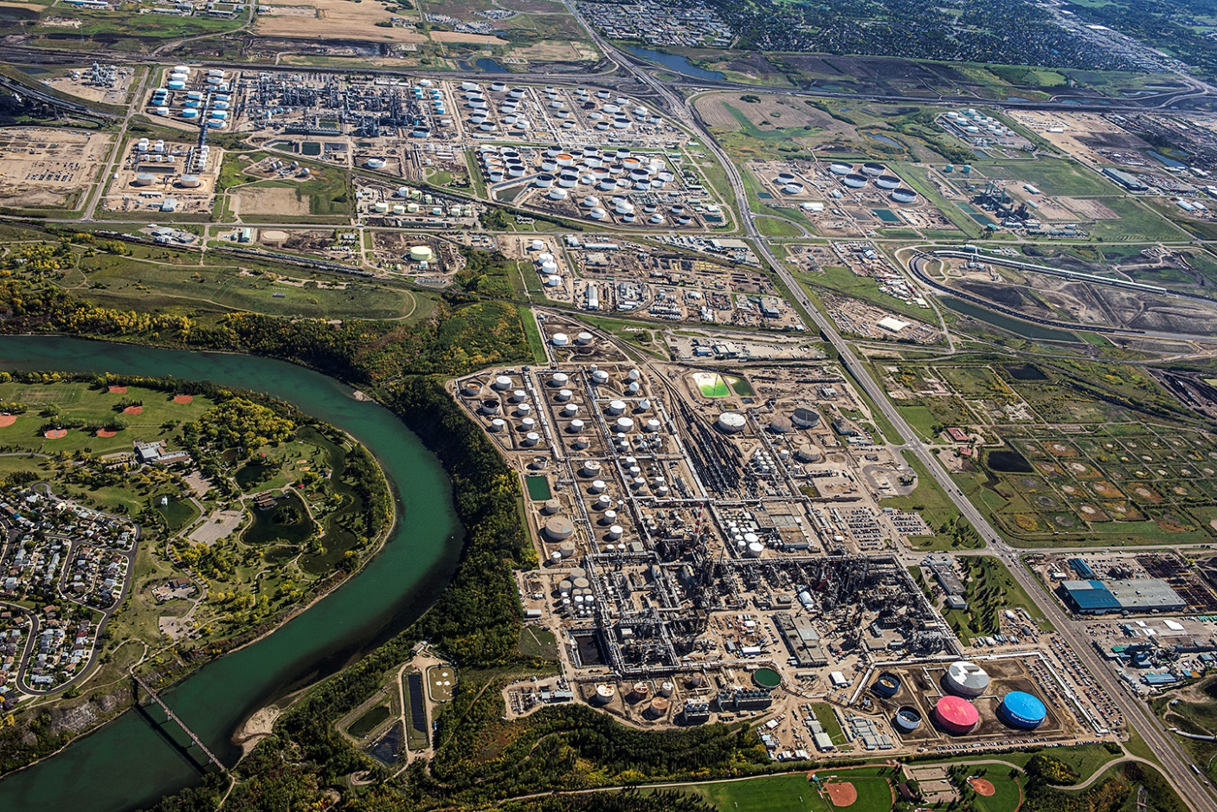
Strathcona Refinery
Suncor
Enbridge
Kinder Morgan
Edmonton Rail Terminal
North
Southlands
South Tank Farm
Strathcona Refinery

Slide 5
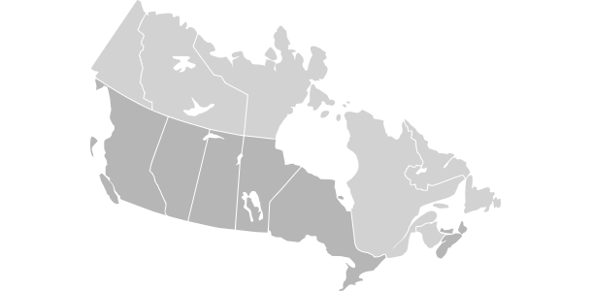
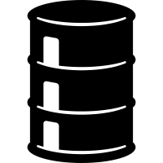



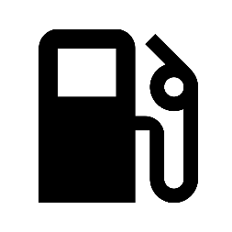


Our Refinery Operation
70+ years
of refining in Alberta
~200K
barrels/day
~30% of Western Canada’s refining capacity
~450 employees
~1000 contractors
¾ of production transportation fuel
~500K fill-ups
a day
Notes:
Operating in the area since 1948.
Current refinery as we know it today opened in 1976.
Being a land-locked refinery means we have to source locally, mostly from our upstream operations in Alberta.
To give you a sense of the scale and scope of our operation:
Approximately 30% of western Canada’s refining capacity
Manufacture a full range of gasoline, diesel, aviation fuels, asphalts, and liquid petroleum gases
Process ~ 200,000 barrels of crude oil per day
¾ of the production is transportation fuel so that equals about 500K fill-ups per day
Supply area from northern Ontario to BC; NWT to northern US
Each year we spend about $500M to operate the refinery and invest an additional $100M in capital improvements.
We have a large employee base with approximately 450 full time employees and 500 contractors.
That number can climb to 2,000 coming through the gates daily during special projects and maintenance shutdowns.

Slide 6
Strathcona Inputs/Outputs
Inputs
Outputs
Refinery
Synthetic crude
Conventional crude
Sour crude (Peace Sour)
Asphalt crude (Cold Lake)
Propane
Regular/E10 Gasoline
Aviation Gasoline
Premium Gasoline
Jet Fuel
Arctic Diesel (LSDL)
Diesel
Heavy Fuel (HFO or bunker)
Asphalt
Diluent/Condensate
Other (Butane, CFB, BzHc..)

Slide 7
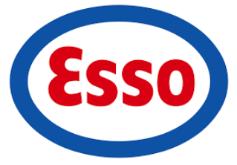
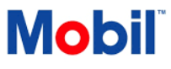
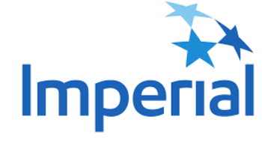
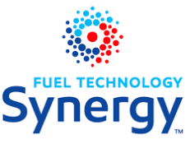

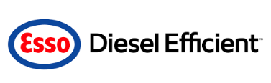
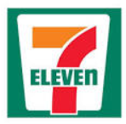

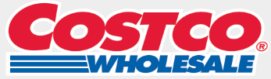


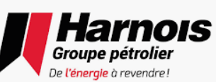
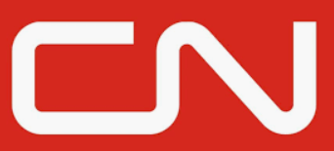


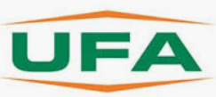
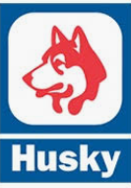





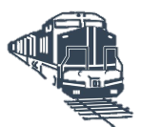



Our Brands and Customers
IOL Businesses
Retail
Wholesale
Branded Reseller
I&C Direct
Brand
Product
Channels / Customers
Wholesale
Wholesale
Wholesale
Retail W
TTBW
Br. Reseller
End User / Customer
Customers shown are for illustrative purposes and are not a comprehensive list
Customer = Who we sell to; End user (consumer) = Who ultimately consumes the fuel.
Notes:
Retail - the Esso/Mobil brand fuel sold at retail stations
Wholesale - fuel sold to customers that resell the fuel under their own brand (UFA, Husky, Centex, Super Save)
Esso Branded Resellers - bulk fuel companies that have signed long term deals that allow them to use the Esso brand. They are exclusively supplied by Imperial.
Ind and Comm - end user customers such as Prairie Mines, CP, CN, Teck Coal

Slide 8
Western Canada Supply Overview
Rail to Prince George
Rail to the North
Fort McMurray
Edmonton
TMPL
SPL
Near or at capacity
APPL
Saskatoon
Opportunity for growth
Enbridge
Winnipeg
Rail to Ontario
Kamloops
Calgary
Regina
WPL
Vancouver
Gretna
Exports / Imports
Exports
Product
Supply spans from Northern Ontario to British Columbia; NWT to Northern US
Full range of oil products and asphalts
~Half of the volume moved by pipelines with balance by rail, truck and even barge
Pipeline constraints are the key challenge
Terminals
Numerous fuels terminal through out Canada
Some terminals shared among others

Slide 9
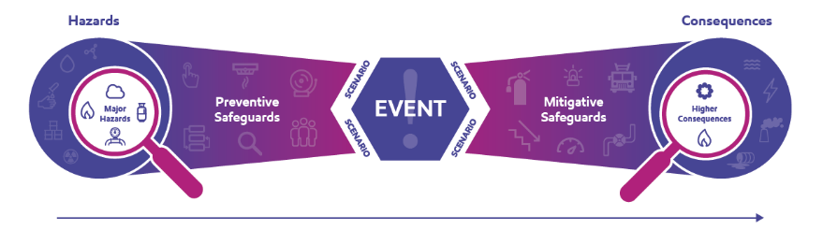
Process Safety – Our Top Priority
We have an important job – it’s critical we do it right.
Getting Process Safety right is the key to success!
What is Process Safety?
Disciplined framework for managing the integrity of our operations – “keep the genie in the bottle”
Includes all aspects of our business were there is potential for adverse impact to our personnel, the public, the environment or our assets
Characterized by application of good design principles, engineering practices, operating practices and emergency preparedness
Primary focus is to prevent and control incidents that have the potential to release hazardous materials and energy
If these incidents occur the result could be toxic exposures, fires, or explosions that have the potential to seriously injure or cause fatal injuries to people, damage property, damage the environment or lose production capacity
Source: www.aiche.org

Slide 10
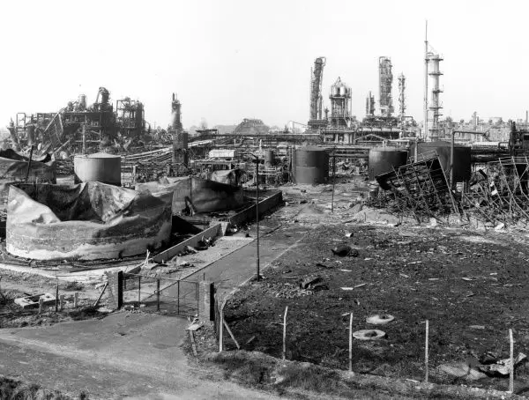
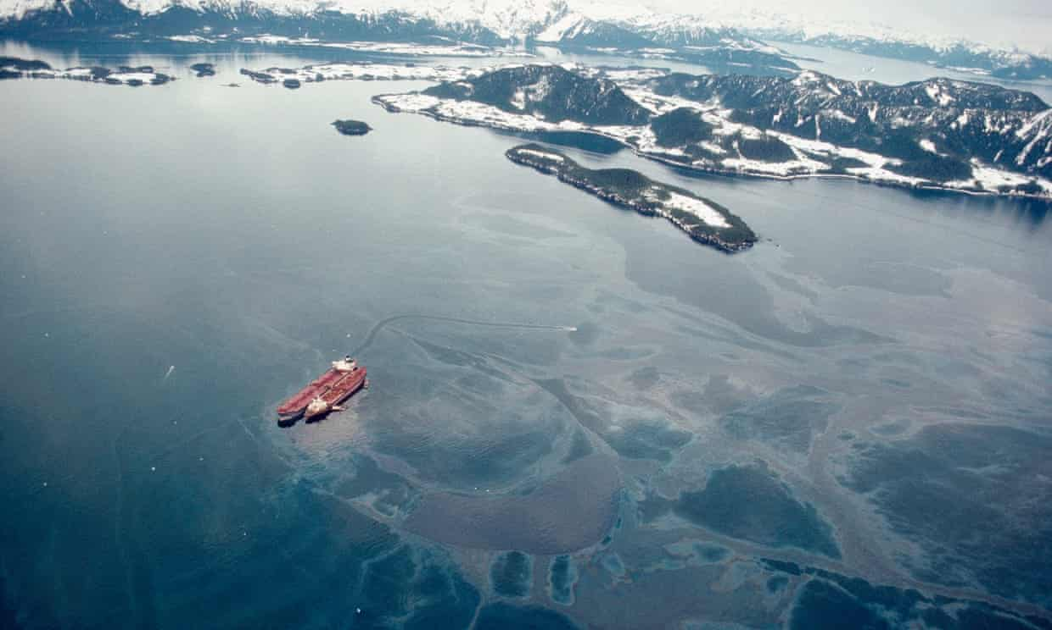
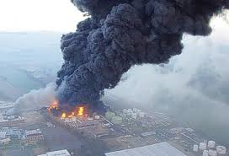
What Does Wrong Look Like?
Philadelphia Energy Solutions: https://www.youtube.com/watch?v=jo4YAX79U2E
BP Texas City: https://www.youtube.com/watch?v=hcKM4xWywLE
Flixborough
Valdez
Buncefield

Slide 11

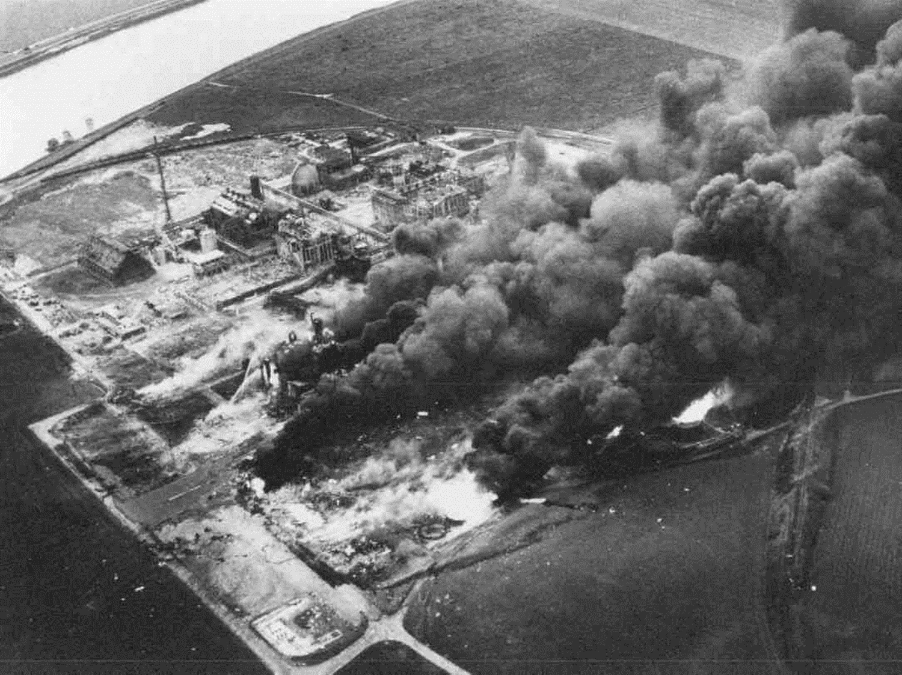
Process Safety – How can we get better?
What happens when process safety goes wrong:
How industry has responded to improve:
Beaumont – 1970
16, 800 gallon leak and fire,
20, 000 gallon vessel fire,
200 ft tower collapse
Mexico City – 1984
500 fatalities
7 000 injuries
Bhopal – 1984
3 000 – 30 000 fatalities
Piper Alpha - 1988
167 fatalities
Texas City – 2005
15 fatalities
180 injuries
$30M damage
$21M fine
Deep Water Horizon – 2010
11 fatalities
17 injuries
130 million gallon leak
Toulouse – 2001
31 fatalities
2 500 injuries
Skikda – 2004
27 fatalities
79 hospitalized
Wisconsin – 2018
15 injuries
Philadelphia – 2019
5 injuries
Permanent facility shutdown
Pasadena – 1989
23 fatalities
103 injuries
Valdez – 1989
$3.2B clean-up
Longford – 1998
2 fatalities, regonial gas shortage for 9 days
Flixborough - 1974
28 fatalities
104 injuries
Seveso - 1976
8 000 people exposed
Qualitative Techniques (i.e. HAZOP)
Quantitative Risk Assessment (QRA)
Safety Case Studies (UK)
API Recommended Practices
Probabilistic Risk Assessment (Nuclear)
ExxonMobil/Imperial development and continuous improvement of Design Practices, Global Practices, Operations Best Practices
Basis for Design Practices and Global Practices and HAZOP methodology
Inherent SHE review method
Risk Matrix Developed
Blast Technology Manual
GMOP, Tier 1 Best Practices
EPS
OIMS Framework Implemented

Slide 12
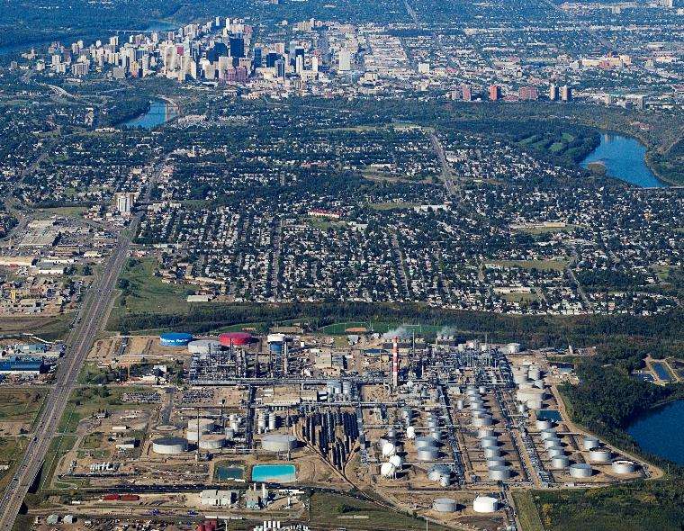
Process Safety and Risk Management
Getting process safety right = managing risks appropriately.
Imperial is in the business of risk management!
Managing to no risk is not an option → Only risks that are identified and clearly assessed can be managed
If risk is managed well, we will operate with greater safety, reliability and efficiency
“Several principles guide us in addressing risk”.
First, we use the best quality science available to understand the nature of the risk.
Second, we prioritize the risks so that we address first those having the greatest potential impacts.
Third, we analyze the costs and benefits of possible solutions to choose those that yield the greatest risk reduction for the resources required.”
Source: Lee R. Raymond, 1999 SHE Progress Report

Slide 13
The Business of Risk Management
What should a company consider when evaluating how to tackle this problem of risk management?
Regulatory compliance – what is expected by the jurisdiction we operate in?
Ongoing risk evaluation - Develop a method to evaluate risk
Design intent – robust guidelines for equipment design with inherent safety built-in
Managing change – change is inevitable, how do you control it?
Robust operating and maintenance practices and procedures
Emergency preparedness – are you prepared if something goes wrong? How do you interact with affected parties outside of your company?
Ongoing risk mitigation with finite resources - Define how to compare risks, who needs to be involved in approving continued operations, define solutions that eliminate, prevent or mitigate escalation
Risk communication – Define who and how to communicate risks to affected personnel
Personnel capability and competency – are my people capable and competent at doing their jobs?
Investigations – if something does go wrong, how do you prevent it from happening again?
Set the need - Who sets the expectations to makes this all happen?
Evaluate how you are performing against expectations - Can this be proactive vs reactive?
Notes:
Design intent – robust guidelines for equipment design with inherent safety built-in
How are the specifications and design basis documentation maintained?
Managing change – change is inevitable, how do you control it?
Proper approval level, risk understood, timeline defined, personnel informed, documentation updated
Robust operating and maintenance practices and procedures
are all aspects of the operation covered by procedures? Start-up, shutdown, emergency response, opening process equipment?
How are these procedures maintained?
Emergency preparedness – are you prepared if something goes wrong? How do you interact with affected parties outside of your company?
Ongoing Risk Evaluation - Develop a method to evaluate risk
How to determine probability associated with the outcome of a defined scenario or failure mode
How to determine the magnitude of the consequence and impacts to people, assets and environment
Ongoing Risk Mitigation with finite resources - Define how to compare risks, who needs to be involved in approving continued operations, define solutions that eliminate, prevent or mitigate escalation
Highest risks get the most focus and resources
The higher the risk, the higher the level of authority required to approve continued operation
Risk mitigated to as low as reasonably practicable, ALARP
Risk communication – Define who and how to communicate risks to affected personnel
Personnel who interact with the risk need to know about and understand the nature of the risk
These same people can provide insights into mitigations
Personnel capability and competency – are my people capable and competent at doing their jobs?
Regulatory compliance – what is expected by the jurisdiction we operate in?
Investigations – if something does go wrong, how do you prevent it from happening again?
Can this be proactive vs reactive?
Who sets the expectations to makes this all happen?

Slide 14
OIMS - How Imperial Manages Risk
The Operations Integrity Management System Framework (OIMS)
Established global expectations for addressing safety, security, health, environmental and social risk inherent in our business
Fundamentally drives risk management throughout all our operations, from top to bottom, focused on establishing “Safety as a Value” and risk management as a cultural mindset
Safety, Security, Health and Environmental (SSHE) performance is monitored, benchmarked, and measured
The standard 11 Elements and 65 Expectations included in OIMS are the same for all employees, no matter where they are in the Company
Notes:
Importance of OIMS
“ExxonMobil’s approach to ensuring integrity in our operations was fundamentally influenced by the 1989 Valdez oil spill. The accident triggered a re-evaluation of our understanding of risk management at a fundamental level. Today, a comprehensive Framework - called the Operations Integrity Management System (OIMS) - underpins every operating decision we make.”

Slide 15
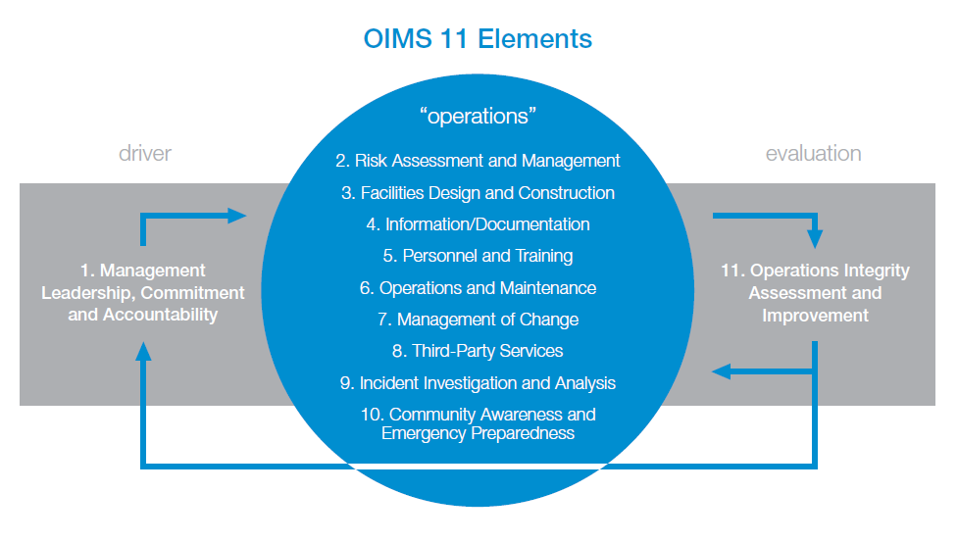
OIMS – How We Manage Risk

Slide 16
APEGA Components of a Managing System
Management Leadership, Commitment, and Accountability
Risk Assessment and Management
Community Awareness and Emergency Preparedness
Management of Change
Incident Reporting, Investigation, Analysis, and Actions
Program Evaluation and Continuous Improvement
Design, Construction, and Start-up
Operations and Maintenance
Employee Competency and Training
Contractor Competency and Integration
Operations and Facilities Information and Documentation
From APEGA Guideline for Management of Risk in Professional Practice, V1.0 September 2006

Slide 17
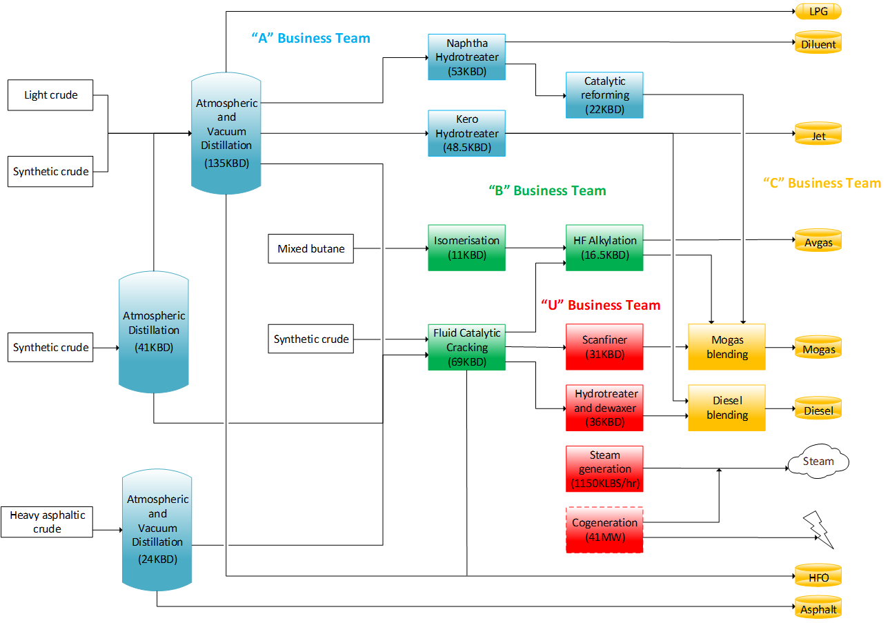
Putting OIMS Into Practice
Flammable Hydrocarbons
Pressure Vessels
Spill Containment
High Temperatures
Mechanical Integrity Programs
Rotating Equipment
Pressurized Equipment
Permitting
Piping
Toxic Chemicals
Electrical Power Systems
Safe Work Procedures
Catalysts
Preventative Maintenance Programs
Security
Storage Tanks
Work Activities with inherent hazards:
Cranes
CSE
Critical Tasks
Hydrotesting
Opening Process Equipment
Excavations
Personal Safety Programs – OH&S
Fired Heaters
Process Controls
Product Quality Specifications and Testing
Safety Relief and Control Systems
Emergency Response Plans

Slide 18
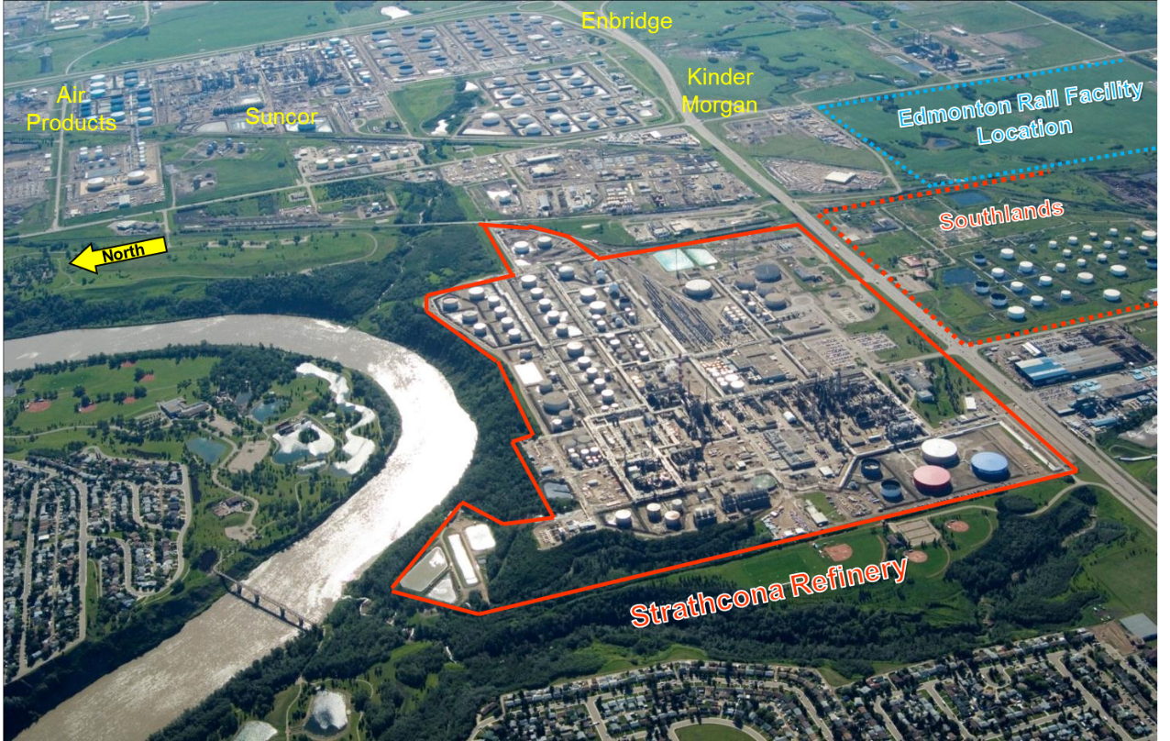
Putting OIMS Into Practice
Residential Neighbours
Emergency Response Plans:
Coordinated with County and City
Coordinated with industrial neighbours
Release from Refinery impacts the public
Industrial Neighbours
Release from the refinery impacts the environment
Steve
N. Saskatchewan River
Incident in other facilities impacts the refinery
Regulatory Approvals
Work activities at the refinery impact the public:
Traffic
Noise
odors
Fenceline Gas and Odor monitoriing
Major Roadways
Fenceline Noise Monitoring
Railways and Yards
Community Engagement
Nearby Parks
Environmental Monitoring Program

Slide 19
OIMS Framework
Notes:
Let’s talk about some of the elements that you’ve learned about in Engg 404. What are some of the key aspects of the element? What objectives do you think the element is trying to achieve?

Slide 20
OIMS Element 1 (APEGA Element 1)
Management leadership, commitment and accountability
Management establishes policy, provides perspective, sets expectations and provides the resources for successful operations.
Assurance of Operations Integrity requires management leadership and commitment visible to the organization.
What strategies would an organization use to meet these objectives?
Why is this element important?
What gets measured gets achieved
Stewarding completion of action items and planned activities
Identify where additional support may be required
What gets measured gets achieved
Stewarding results of management system results
Identify where additional support may be required
Continuous Improvement: current performance and trend analysis
Safety Performance Metrics
Walk the talk - Field presence of leadership drives accountability and ensures compliance with expectations
Leadership Tours and Field Inspections
Notes:
Ask the questions – give 1 minute to confer with their neighbours then ask for feedback. Look for answers to include things like:
Review and steward incidents and near misses with root causes associated with leadership
Review and steward how we are executing our planned risk assessments, status of incident follow-ups, prior assessment follow-ups
Process safety, Injury, environmental, security and health performance metrics
Field tour completions – leadership presence in the organization is planned and results/completions are measured

Slide 21
OIMS Element 11 (APEGA Element 6)
Operations integrity assessment and improvement
Assessment of the degree to which expectations are met is essential to improve Operations Integrity and maintain accountability.
“What get measured gets managed” – Peter Drucker
How do you think an organization meet this objective?
Why is this element important?
Annual assessments of Managing System
Stewardship of open follow-ups from previous assessments
Stewardship of field inspection completions
Management participation in other sites assessments
Review of progress on Risk Assessment recommendations
Notes:
Annual assessments of managing system – internal team supplemented with external assessors yearly and an externally led assessment every 3 years.
Regular review and stewardship of open follow-ups from past assessments for each OIMS element with site management
Review and steward leadership tour results
Management participates in other sites assessments for global alignment of management team
Review risk assessment recommendations status

Slide 22
OIMS Element 7 (APEGA Element 4)
Management of change
Changes in operations, procedures, site standards, facilities, or organizations must be evaluated and managed to ensure that Operations Integrity risks arising from these changes remain at an acceptable level.
What should be considered in order to properly managing changes?
Why is this element important?
Proper authority level defined to approve change
Risk of change properly assessed
Standards and Regulations that apply
Communication and training plan defined
Timeline of change – temporary or permanent
Notes:
Ask the questions – give 1 minute to confer with their neighbours then ask for feedback. Look for answers to include things like:
Proper level of authorization for the change
Proper assessment of the risk the change poses
Review of any standards and regulations that would apply to the change
Communication and training required for the organization to understand the change
Time line for the change – temporary, permanent, start and end date

Slide 23
OIMS Element 9 (APEGA Element 5)
Incident investigation and analysis
Effective incident investigation, reporting and follow-up are necessary to achieve Operations Integrity.
Proper investigations provide the opportunity to learn from reported incidents and to use the information to take corrective action and prevent recurrence.
Why is this element important?
Proper investigations provide the opportunity to learn from reported incidents and to use the information to take corrective action and prevent reocurrence.
"Those that fail to learn from history, are doomed to repeat it." Winston S. Churchill
Notes:
Ask the questions – give 1 minute to confer with their neighbours then ask for feedback. Look for answers to include things like:
Defined investigation protocol – assess the potential learning value of each incident to ensure correct level of investigation is completed
Trained investigation leaders
Key Steps to investigations:
Assemble investigation team – ID team leader, gather involved personnel
Gather facts
Define timeline and develop description of incident/near miss
Identify direct causes
Identify root causes that led to the direct cause to occur – techniques range from simple “5 why” to more advanced tools like tap root and CFWT
Identify solutions to address root causes

Slide 24
Summary
Effective risk management requires:
Strong leadership to ensure objectives are being met
Robust Managing System that is effective – including a way to measure effectiveness of the Managing System and its elements
A comprehensive risk assessment process that provides guidance for informed decision-making
Detailed investigation process to ensure failures are understood and solutions are effective to prevent reoccurrences
Corporate guidance encourages risk prioritization and cost effective allocation of resources, but will stop short of defining a “line in the sand” for acceptable risk
Times are changing....the bar is getting higher, and risk tolerance is getting lower
Notes:
If there are any questions please feel free to ask and I’ll answer them the best I can
If no,
I’ll hand it back to your professor (John) to get you geared up for the refinery tour. Enjoy your tour!

Slide 25
Questions?

